Slide 1
Data Stores

Slide 2
Topics Covered
Data Lake
Data Warehouse
Data Mart

Slide 3
Data Lake

Slide 4
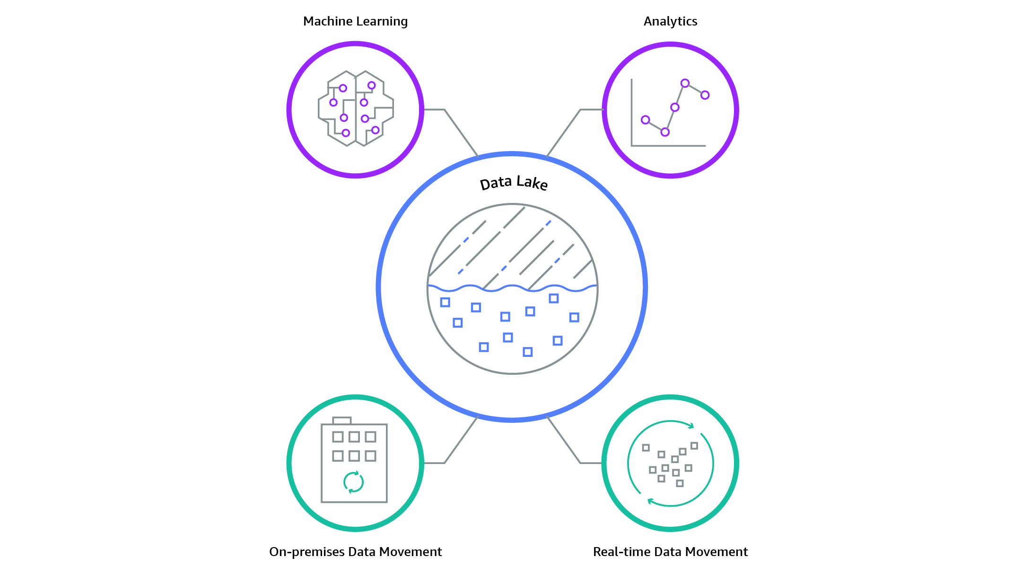
Data Lake
A data lake is a centralized repository that allows you to store all your structured and unstructured data at any scale.
You can store your data as-is, without having to first structure the data, and run different types of analytics—from dashboards and visualizations to big data processing, real-time analytics, and machine learning to guide better decisions.

Slide 5
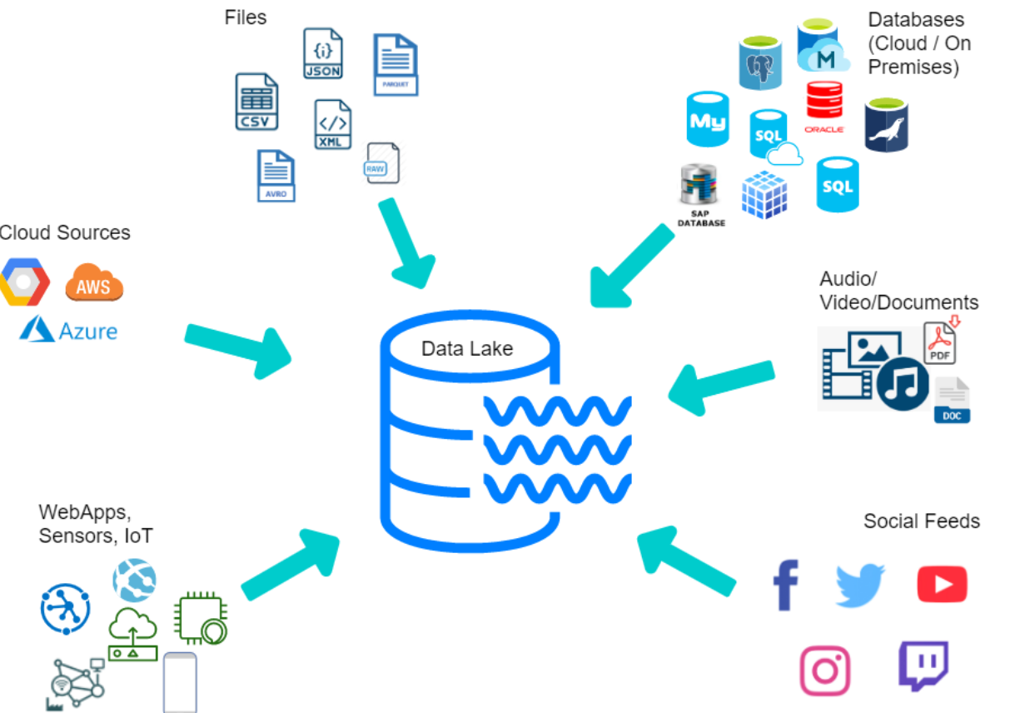

Slide 6
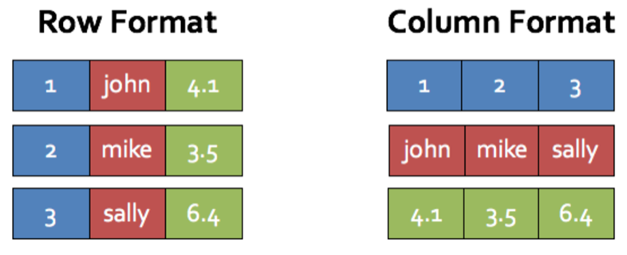
File Formats
Row Based
CSV
JSON
AVRO
Column Format
ORC
Parquet

Slide 7
AVRO
Row Based Storage
All record data are stored together
Schema Stored In JSON
Easy for humans to read
Data Stored in Binary
Easy for computers to read
Benefits:
Easily handles schema changes
Great for write-heavy workloads
Great for ETL operations that need all columns

Slide 8
Parquet
Columnar Storage
Values of each column types are stored together
Nested Data Structures
Nested fields can also be read individually
Data Stored in Binary
Easy for computers to read
Benefits
Great for wide column queries
Efficient for read heavy workloads
Easily queries a subset of columns or nested data

Slide 9
ORC (Optimized Row Columnar)
Columnar Storage
Values of each column types are stored together
Stripes
Collections of rows that contain row data in columnar format
Data Stored in Binary
Easy for computers to read
Benefits:
Supports ACID properties
Compress more efficiently
Stripes enable large, efficient reads

Slide 10
Data Lake Zones
Experimental
A sandbox where data scientists can combine multiple datasets
Production
Easy access point for consumers that includes business logic
Curated
Transformed into consumable datasets
Staging
First step to refinement by adding basic structure
Landing
Raw in original state

Slide 11
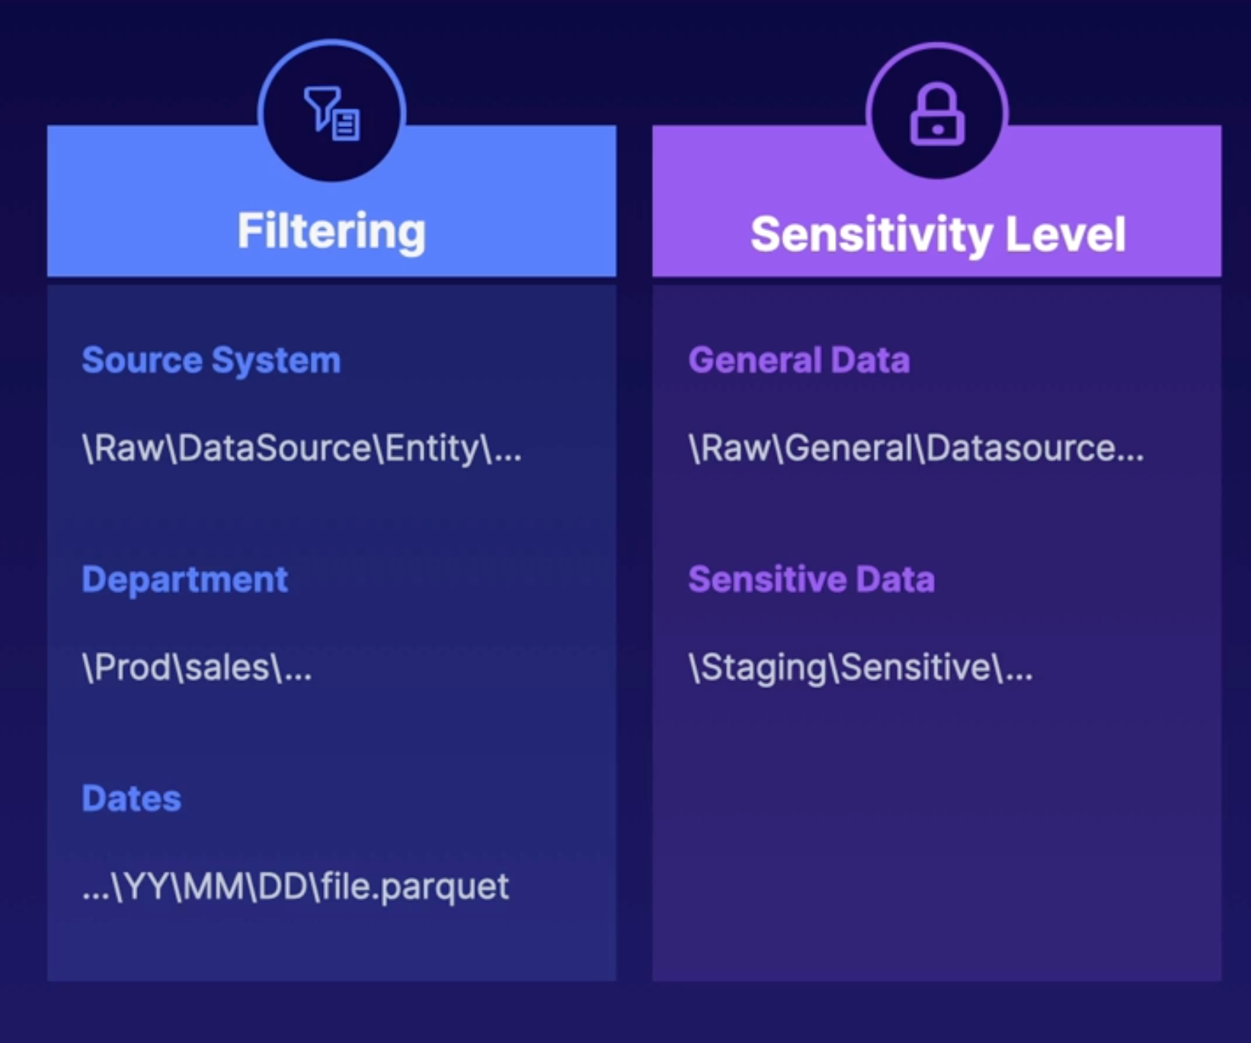
Folder Structure Strategy
Simple
Human readable
Self Documenting
Appropriately Granular
Effective Permissions
No maintenance overhead
Thoughtful Partitioning
Align with purpose of zone
Group Similar Items
Same schema and file format

Slide 12

Data Catalog
Data catalog centralized metadata repository for all your data assets across various data sources.
It provides a unified interface to store and query information about data formats, schemas, and sources.
Data Catalog Services:
AWS Glue Data Catalog
Hive Metastore
Google Cloud Data Catalog

Slide 13

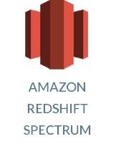

Accessing Data
What's next after creating the data catalog ?
There are many cloud services that offer querying the files in data lake by using the data catalog
SQL:
Athena
S3 Select
Redshift Spectrum
Code
AWS Glue -> Python / Spark
AWS SDK

Slide 14
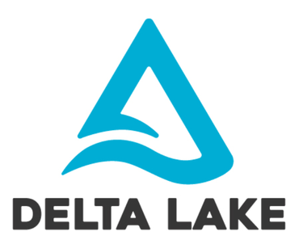


Data Lake - Frameworks
ACID transactions
Scalable metadata handling
Change data feeds
Time travel (Data versioning)
Open format
Unified batch and streaming source and sink
Schema enforcement
Schema evolution
Audit History
Updates and deletes

Slide 15
Data Warehouse

Slide 16




Data Warehouse
A data warehouse is a central repository of information that can be analyzed to make more informed decisions.

Slide 17
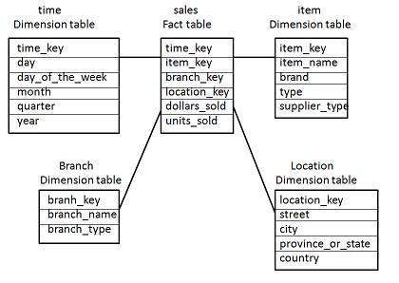
Warehouse Concepts
Fact Table - a table that stores the measurements, metrics, or facts related to a business operation.
Dimension Table - descriptions of the objects in a fact table and provide information about dimensions such as values, characteristics, and keys.
Schema:
Star Schema
Snowflake Schema
Fact Constellation Schema

Slide 18
Functions of Data Warehouse
Data Extraction - Involves gathering data from multiple heterogeneous sources.
Data Cleaning - Involves finding and correcting the errors in data.
Data Transformation - Involves converting the data from legacy format to warehouse format.
Data Loading - Involves sorting, summarizing, consolidating, checking integrity, and building indices and partitions.
Refreshing - Involves updating from data sources to warehouse.

Slide 19
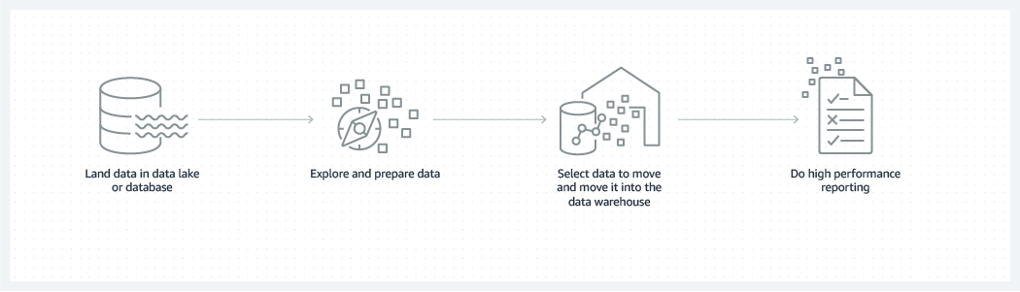
Data Flow
Sources:
Data flows into a data warehouse from transactional systems, relational databases, and other sources, typically on a regular cadence.
Users:
Business analysts, data engineers, data scientists, and decision makers
Targets:
Business Intelligence Tools (Power BI, Quicksight), SQL clients, and other analytics applications..

Slide 20
Data Mart

Slide 21
Introduction
Data Mart is a subset of a data warehouse that focuses on a specific business area or department within an organization.
It is designed to provide a tailored view of data to meet the specific needs of a particular group of users.
Data Mart contains summarized and pre-aggregated data that enables faster analysis and decision-making.

Slide 22
Types of Data Mart
Dependent:
A dependent data mart populates its storage with a subset of information from a centralized data warehouse.
Independent:
An independent data mart does not rely on a central data warehouse or any other data mart.
Hybrid:
Hybrid data marts collect information from a data warehouse and from external sources.

Slide 23
Structure of Data Mart
Star :
The star structure has a fact table at its center and branches to several dimension tables. This results in a star-shaped connection. The fact table is a data table that contains summarized data that you can use for analytical purposes. Meanwhile, dimension tables hold descriptive information in a fact table.
Denormalised:
A denormalized structure stores all the related data in a single table. It does not have complex joints between fact tables and dimension tables.

Slide 24
Benefits
faster data retrieval and analysis.
better decision-making.
specific departments or business areas.
scalability and flexibility.

Slide 25
UseCases
Sales and Marketing
Finance and Accounting
Human Resources
Supply Chain and Operations

Slide 26
Summary

Slide 27
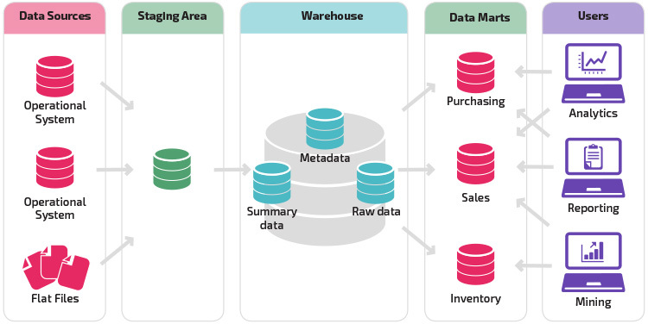
Overview

Slide 28
References:
data-warehouse
data-mart
data-lake
data-warehouse-1
To – Do:
Take a look into the documentations and come up with a draft of what is what based on your understanding and an example if possible (SuperMarket)

Slide 29
Questions?

Slide 30
Thank You

